Slide 1



SPACEX FALCON 9 LAUNCH COST OPTIMIZATION AND REUSABILITY PREDICTION
A DATA SCIENCE–DRIVEN APPROACH USING PUBLIC SPACEX DATA
CAPSTONE PROJECT | IBM DATA SCIENCE PROFESSIONAL CERTIFICATE
Presented by
Durga Vani Moka
01

Slide 2

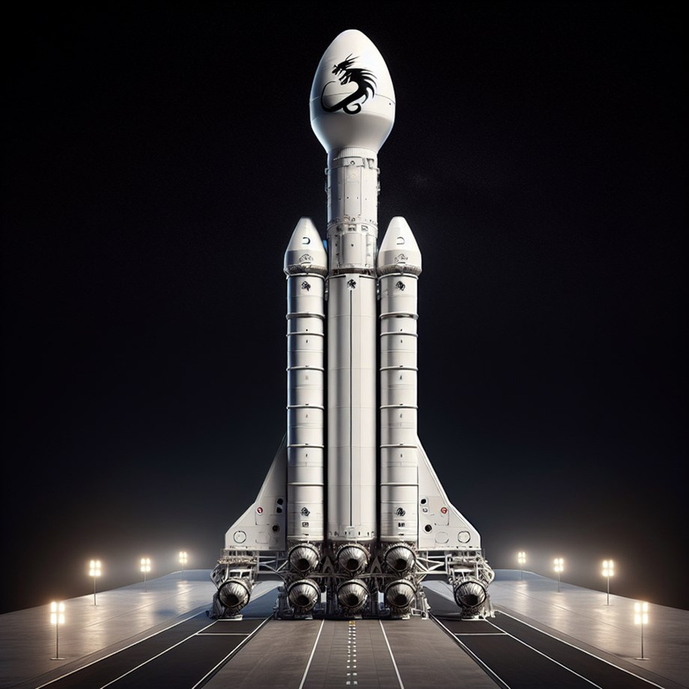
EXECUTIVE SUMMARY
This project analyzes SpaceX Falcon 9 launch data to understand launch cost factors and first-stage reusability.
Public data from SpaceX APIs and web sources was collected, cleaned, and analyzed.
Exploratory data analysis, SQL analysis, and interactive visualizations were performed.
A machine learning classification model was built to predict first-stage reuse.
Insights were delivered through dashboards and interactive maps to support data-driven decision-making.
02

Slide 3
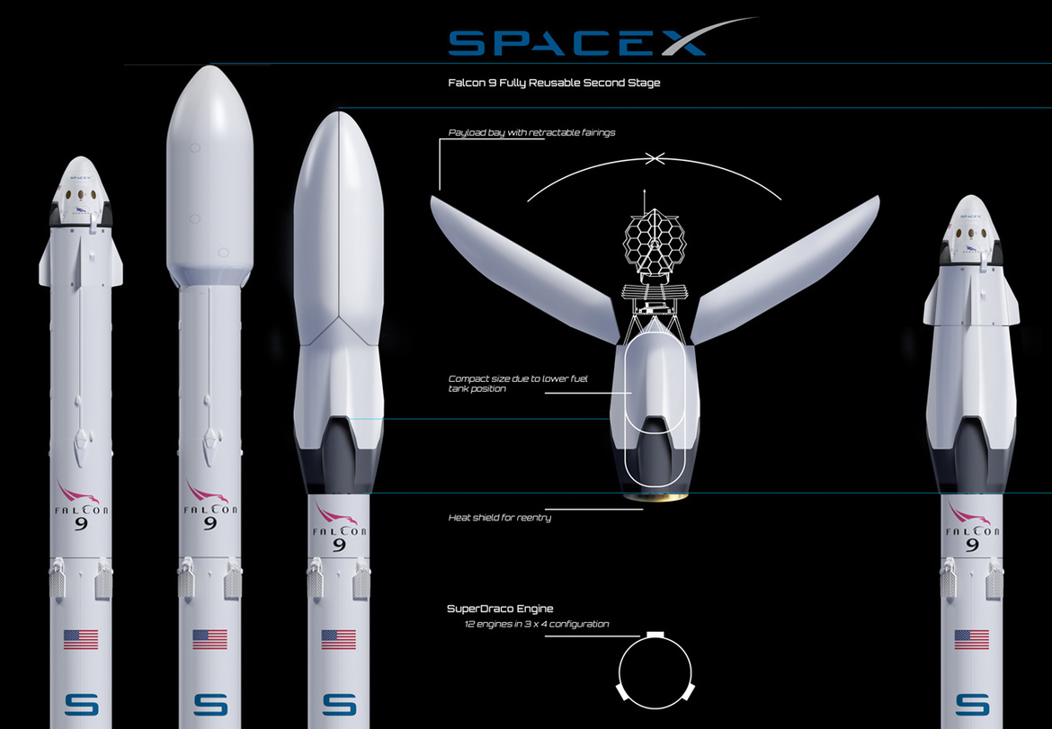
INTRODUCTION
SpaceX’s Falcon 9 achieves significantly lower launch costs by reusing the first-stage booster.
Falcon 9 launches cost approximately $62 million, compared to $165+ million for other providers.
The success of first-stage landing directly impacts launch cost and reusability.
This project focuses on predicting whether the Falcon 9 first stage will land successfully using historical data.
Accurate prediction enables indirect estimation of launch cost and risk, supporting competitive bidding decisions.
Objective: Predict first-stage landing success to estimate launch cost impact.
03

Slide 4

DATA COLLECTION & DATA WRANGLING METHODOLOGY
Collected Falcon 9 launch data from SpaceX REST APIs and Wikipedia.
Integrated multiple sources into a single dataset.
Cleaned and prepared data by handling missing values and standardizing features.
Created the target variable for first-stage landing success.
04

Slide 5
EXPLORATORY DATA ANALYSIS (EDA) – METHODOLOGY
Performed exploratory data analysis (EDA) to identify patterns related to first-stage landing success.
Analyzed relationships between payload mass, orbit type, launch site, and flight number.
Used statistical plots and interactive visualizations to compare successful vs unsuccessful landings.
Built interactive charts and dashboards to enable dynamic exploration of launch outcomes.
05

Slide 6

PREDICTIVE ANALYSIS METHODOLOGY
Defined the prediction problem as a binary classification task.
Selected relevant features related to launch conditions and mission characteristics.
Split the data into training and testing sets.
Trained multiple machine learning classification models to predict first-stage landing success.
Evaluated model performance using accuracy and classification metrics.
07

Slide 7
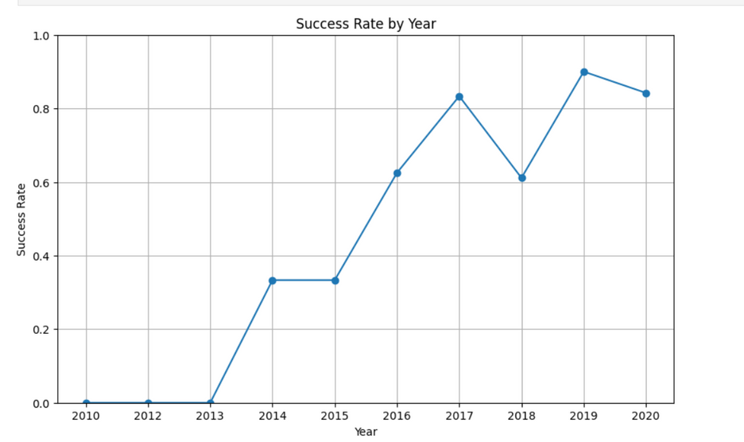
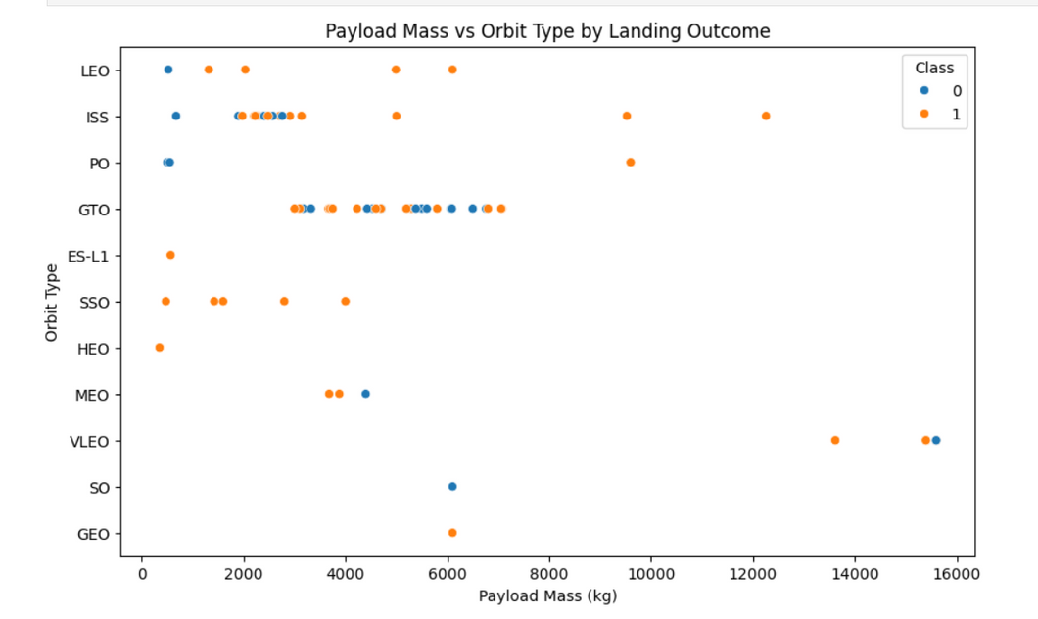
EDA WITH VISUALIZATION RESULTS
Key Insights
Landing success rate improves over time, indicating increased operational experience and reuse capability.
Payload mass and orbit type influence landing outcomes, with certain orbits showing higher success rates.
More complex missions (higher payloads and specific orbits) show greater variability in landing success.
06

Slide 8
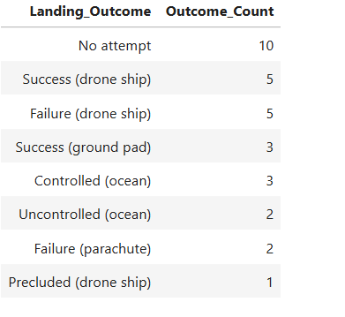
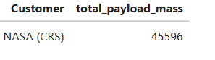
EDA WITH SQL RESULTS
Key Insights
SQL analysis shows a strong dominance of successful missions over failures.
Landing outcome type (drone ship or ground pad) plays a critical role in booster reusability.
These results highlight imbalanced classes, which is important for predictive modeling.
NASA CRS missions carried a total payload mass of 45,596 kg, highlighting their significant contribution to Falcon 9 launch activity.
08

Slide 9
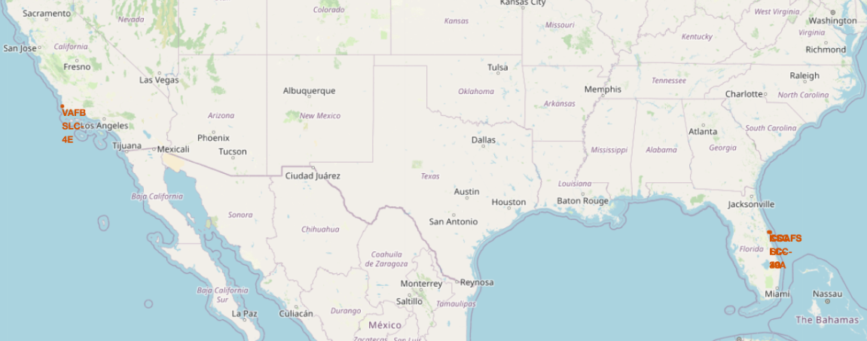
INTERACTIVE MAP RESULTS (FOLIUM)
Visualized Falcon 9 launch site locations across the United States.
Launch activity is concentrated at CCAFS LC-40, KSC LC-39A, and VAFB SLC-4E.
Coastal launch locations support recovery operations and landing strategies.
Geographic distribution influences mission planning and first-stage reusabilities.
09

Slide 10
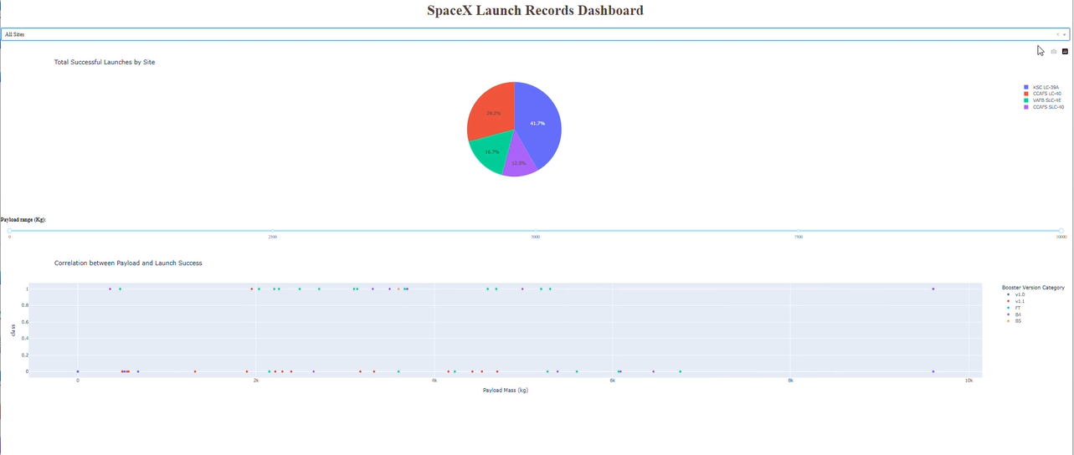
INTERACTIVE DASHBOARD BUILT WITH PLOTLY DASH.
Built an interactive dashboard using Plotly Dash to analyze Falcon 9 launch data.
Visualizes successful launches by site and payload mass vs launch success.
Provides interactive filters for launch site and payload range.
Enables stakeholders to explore patterns affecting first-stage landing success.
11

Slide 11
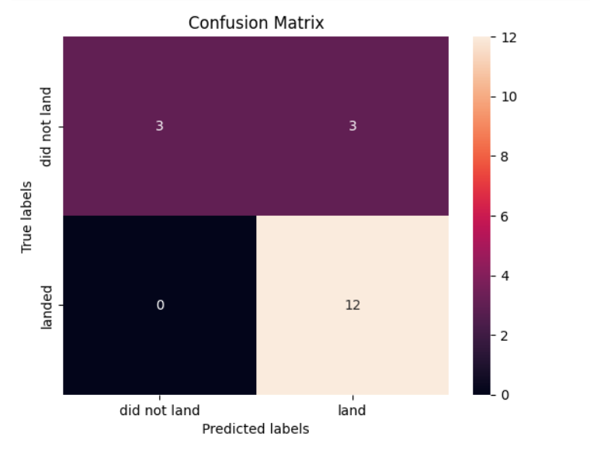
PREDICTIVE ANALYSIS (CLASSIFICATION) RESULTS
Multiple classification models (Logistic Regression, SVM, KNN, Decision Tree) were trained and evaluated.
All models achieved a similar accuracy of approximately 83% on the test data.
Models showed high recall for successful landings, indicating strong ability to predict reuse.
Lower recall for failure cases highlights the impact of class imbalance and limited data.
The model predicts successful landings more reliably than failures.
11

Slide 12

CONCLUSION
This project demonstrates how public SpaceX launch data can be transformed into actionable insights.
Analysis shows that first-stage reusability is predictable using historical mission characteristics.
The predictive model achieves ~83% accuracy, enabling risk-aware launch cost estimation.
Interactive dashboards and maps allow stakeholders to explore launch performance and reuse patterns without technical expertise.
These insights support competitive bidding, cost optimization, and strategic planning for commercial launch providers.
10

Slide 13

THANK YOU
Thank you for your time and attention.
This presentation demonstrated a data-driven approach to predicting Falcon 9 first-stage reusability and estimating launch cost impact.
I welcome any questions, feedback, or discussion on the analysis and results.
Name: Durga Vani Moka
Project: IBM Data Science Professional Certificate – Capstone
Focus: Launch Cost Estimation & Reusability Prediction

